Slide 1
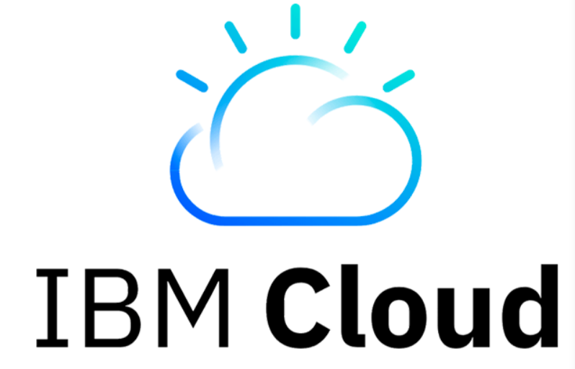
CI/CD workflow
Team 3
Chaitanya Subhash
Srinija
Swaroop
Viswanth
Priyanka

Slide 2
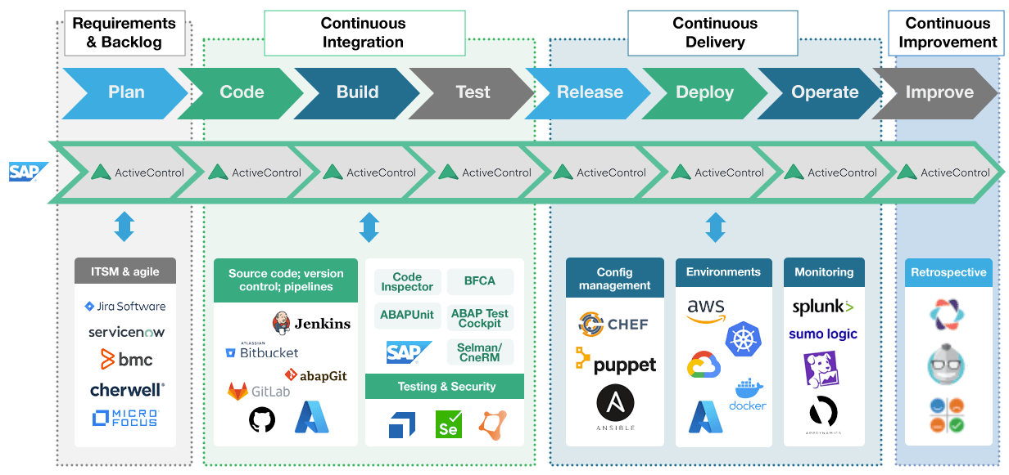
What is CI/CD ?
(CI/CD) pipeline is an automated DevOps workflow that streamlines the software delivery process.

Slide 3
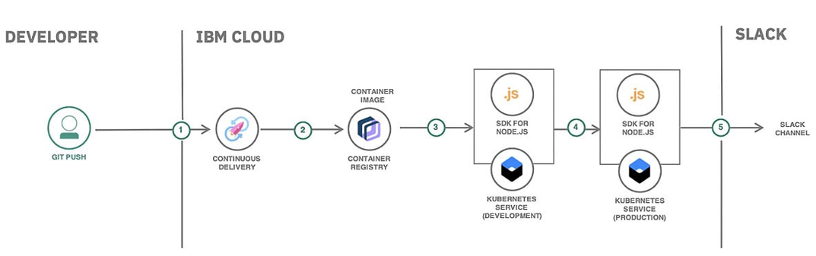
CI/CD workflow in IBM Cloud
This pipeline can build microservices-based application source code from GitHub, create multi-architecture Docker images, and deploy them to across public and private cloud environments.
How to deploy source code with IBM Cloud Code Engine
Deploy an app on Kubernetes | IBM Cloud Docs
Notes:
This CI/CD pipeline ensures an automated and structured process for deploying a Node.js application on IBM Cloud Kubernetes Service. The pipeline integrates Continuous Delivery, Container Registry, Kubernetes Deployment, and Slack Notifications to ensure a smooth software development lifecycle.
Step-by-Step Breakdown
1. Developer Pushes Code to Git Repository
A developer pushes new code changes to a Git repository (e.g., GitHub, GitLab, IBM Cloud Git Repos).
This action triggers the CI/CD pipeline.
2. Continuous Delivery (CI/CD Pipeline in IBM Cloud)
IBM Cloud Continuous Delivery automatically starts the build process.
The pipeline pulls the latest code, installs dependencies, and runs tests.
3. Container Image Creation & Storage in IBM Cloud Container Registry
The CI/CD pipeline builds a Docker container image for the Node.js application.
The image is then stored in IBM Cloud Container Registry to ensure version control and easy deployment.
4. Deployment to IBM Cloud Kubernetes Service (Development & Production)
The containerized application is first deployed to a Kubernetes cluster for development (staging environment).
Once testing is successful, the application is promoted to the production Kubernetes cluster.
5. Slack Notification for Deployment Status
The pipeline sends a Slack notification to a predefined Slack channel, informing team members about the deployment status.
This improves collaboration and monitoring of the deployment process.
Key Features for a High Grade
Automated CI/CD Workflow: Ensures efficiency, consistency, and reliability in software deployment.
Containerization with IBM Cloud: Docker-based deployment enhances portability and scalability.
IBM Kubernetes Service for Dev & Prod: Separating development and production environments improves testing and stability.
Slack Integration for Monitoring: Provides real-time deployment updates, ensuring team awareness.
Best Practices in DevOps: Implements key DevOps principles—automation, continuous integration, continuous deployment, and monitoring.

Slide 4
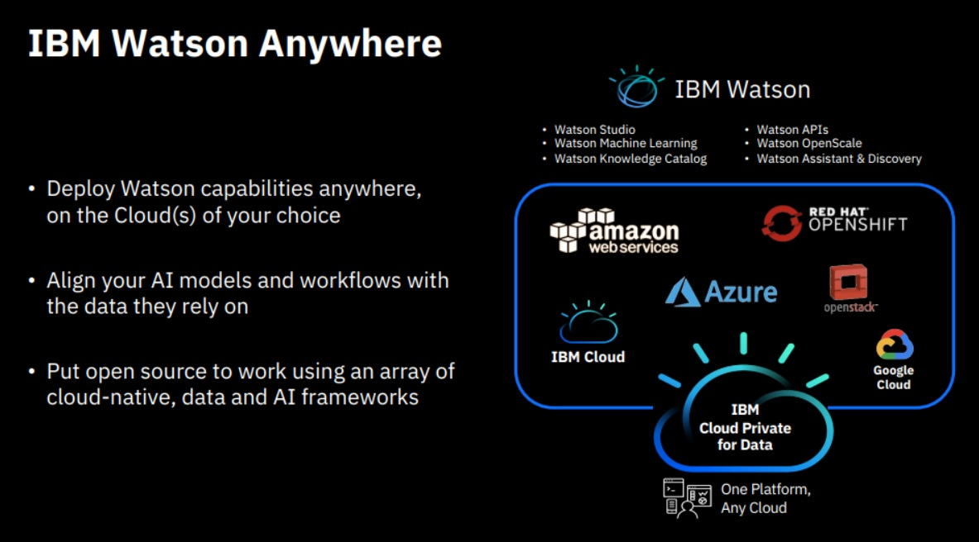
What is IBM Watson?
It is an advanced artificial intelligence system developed by IBM, designed to process and analyze large amounts of data.
Notes:
IBM Watson is an advanced AI system developed by IBM to process and analyze large amounts of data. It offers flexibility through IBM Watson Anywhere, allowing deployment across multiple cloud platforms, including IBM Cloud, AWS, Azure, Google Cloud, Red Hat OpenShift, and OpenStack.
Watson supports AI-driven workflows with services like Watson Studio, Machine Learning, Knowledge Catalog, APIs, OpenScale, and Assistant & Discovery.
By integrating with various cloud environments and open-source frameworks, IBM Watson enhances data-driven decision-making and enables businesses to leverage AI effectively.
AI and Data Integration – It aligns AI models and workflows with the data they rely on, ensuring efficient AI-driven insights.
Open Source Compatibility – Watson supports open-source AI frameworks and cloud-native technologies, allowing for customization and integration with various data frameworks.
Why is IBM Watson Important?
Enhances AI adoption across industries
Provides scalable and flexible AI solutions
Supports automation and decision-making
Integrates with various cloud services and open-source platforms

Slide 5
How IBM Watson useful in CI/CD?
IBM Watson is helpful in cloud deployments by simplifying the process, reducing upfront costs, and allowing businesses to focus on leveraging AI for innovation.
IBM Watson can be integrated with IBM Cloud DevOps Services, such as Toolchains, to enhance the CI/CD pipeline. For example:
IBM Cloud Continuous Delivery: Watson can automate tasks like code deployment, testing, and monitoring in the pipeline.
IBM Cloud Monitoring and Logging: Watson can analyze logs and performance metrics from IBM Cloud to provide insights and alerts about the application’s health.
Notes:
Introduction
So, let’s talk about how IBM Watson can make CI/CD workflows smarter and faster.
CI/CD is all about automating software delivery, and Watson brings AI magic to the process by helping teams work more efficiently and avoid common roadblocks.
Let’s talk about Key Benefits
Watson automates the boring stuff, like generating test cases or analyzing logs, so your team can focus on the big-picture tasks.
It predicts potential issues before they happen, saving you from last-minute deployment chaos.
Plus, it offers smart insights to optimize your pipeline—helping you work smarter, not harder.
This is all fine but let’s discuss the Use Cases
Automated Testing: Watson creates test cases automatically and flags problems during testing itself instead of going through final phase.
Predictive Analytics: It predicts build failures and helps you speed up deployments.
Monitoring: Watson analyzes logs, pinpoints issues, and even suggests fixes.
Security: It scans your code for vulnerabilities to ensure everything’s secure.
Why It’s Game-Changing
Let’s Imagine this: Watson analyzes your test results, and found a potential bug, and suggests a fix before you even notice it. Meanwhile, your team gets updates from a chatbot without having to dig through logs.
It’s like having an AI-powered teammate that never takes a break!
Real-World Impact
By automating tasks, Watson reduces delays and helps you release software faster.
It improves software quality by catching issues early and ensures compliance with security standards.
And the best part? It saves time and money, all while boosting collaboration within your team.
Everything seems fine but what is the catch here, not everything can be perfect.
Quick Considerations
Of course, integrating Watson into your pipeline takes some setup and expertise.
And yes, AI solutions like this aren’t free, but the long-term benefits—faster releases, fewer bugs, and happier teams—are worth it.
Closing
IBM Watson isn’t just a tool; it’s a game-changer for CI/CD.
With its AI-driven automation, insights, and problem-solving abilities, Watson takes software delivery to the next level.

Slide 6
THANK YOU

